Slide 1
Input-Output Processor (IOP), CPU-IOP Communication
(Lecture 51-53)

Slide 2
Input–Output Processor (IOP)
The communication between the IOP and the devices is similar to the program control method of transfer and the communication with the memory is similar to the direct memory access method.
The CPU can act as master and the IOP act as slave processor. The CPU assigns the task of initiating operations where as IOP executes the instructions, and not the CPU.
CPU assigns the task of initiating the I/O operation by testing the status of IOP. If the status is fine, the processor continues its other works and IOP handles the I/O operation.
After the input is completed, IOP transfers its content to memory by stealing one memory cycle from CPU. Similarly, an output is directly transferred from memory to IOP, stealing a memory cycle and from IOP to the output device at a rate the device accepts the output as shown in figure on next slide.

Slide 3
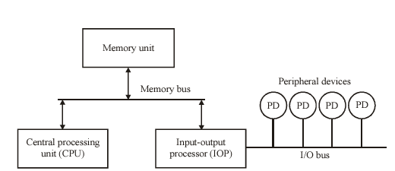
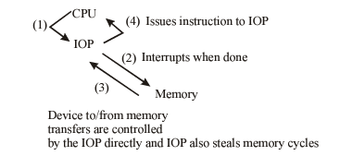
Input–Output Processor (IOP)
IOPs are also called Peripheral Processing Unit (PPU). IOPs are also called I/O Channels in Mainframe.
Instructions that are read from memory by an IOP are also called commands to distinguish them from instructions that are read by CPU. Commands are prepared by programmers and are stored in memory. Command words make the program for IOP. CPU informs the IOP where to find the commands in memory as shown in below figure named “data transfer between IOP and CPU” .
Block Diagram of an IOP
Data Transfer between IOP and CPU

Slide 4
Working of Input-Output Processor
The IOP interacts with CPU by means of interrupt. Also, for ending the instruction, an interrupt is sent to CPU.
CPU initiate IOP program in main memory.
An I/O device requests the IOP when it needs to access or store data in memory. The IOP then asks the Processor to hold by sending it a Hold request (HLD). When the CPU receives a hold request, it sends the IOP a hold acknowledgment (HLDA) and IOP takes control of the system bus and permits data transfer.
The IOP again emits an interrupt once the data transfer is accomplished to notify the CPU that the transfer is complete.

Slide 5
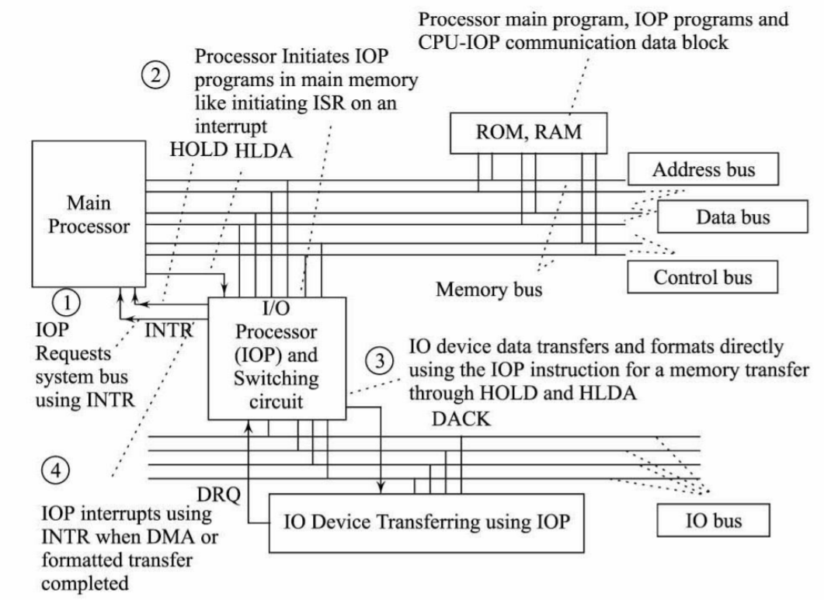
Working of Input-Output Processor (Cont..)
Working of Input-Output Processor

Slide 6
IOP - IBM 370 I/0 Channel
The I/O processor in the IBM 370 computer is called a channel. A typical computer system configuration includes a number of channels with each channel attached to one or more I/O devices.
There are three types of channels: multiplexer, selector, and block- multiplexer.
The multiplexer channel can be connected to a number of slow- and medium-speed devices and is capable of operating with a number of I/O devices simultaneously.
The selector channel is designed to handle one I/O operation at a time and is normally used to control one high-speed device.
The block-multiplexer channel combines the features of both the multiplexer and selector channels. It provides a connection to a number of high-speed devices, but all I/O transfers are conducted with an entire block of data as compared to a multiplexer channel, which can transfer only one byte at a time.

Slide 7
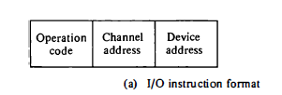
IBM 370 I/0 Channel – Instruction Format
The I/O instruction format has three fields: operation code, channel address,
and device address as shown below.
The computer system may have a number of channels, and each is assigned an address. Similarly, each channel may be connected to several devices and each device is assigned an address.
The operation code specifies one of eight I/O instructions:
start I/O, 2. start I/O fast release,
3. test I/O, 4. clear I/O,
5. halt I/O, 6. halt device,
test channel, 8. store channel identification

Slide 8
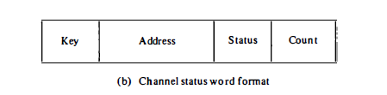
IBM 370 I/0 Channel – Channel Status Word
The format of the channel status word is shown below. It is always stored in location 64 in memory.
The key field is a protection mechanism used to prevent unauthorized access by one user to information that belongs to another user or to the operating system.
The address field (where to put data) in the status word gives the address of the last command word used by the channel.
The count field (how much) gives the residual count when the transfer was terminated. The count field will show zero if the transfer was completed successfully.
The status field identifies the conditions in the device and the channel and any errors that occurred during the transfer.

Slide 9

IBM 370 I/0 Channel – Channel Command Word
The format of the channel command word is shown below.
data address field specifies the first address of a memory buffer.
count field gives the number of bytes involved in the transfer.
command field specifies an I/O operation.
flag bits provide additional information for the channel.
The command field corresponds to an operation code specifies one of six basic types of I/O operations.

Slide 10
Command Field Operations Code
The command field corresponds to an operation code that specifies one of six basic types of I/O operations:
1 . Write - Transfer data from memory to I/O device.
2. Read - Transfer data from I/O device to memory.
3. Read backwards - Read magnetic tape with tape moving backward.
4. Control - Used to initiate an operation not involving transfer of data, such as rewinding of tape or positioning a disk-access mechanism.
5. Sense - Informs the channel to transfer its channel status word to
memory location 64.
6. Transfer in channel - Used instead of a jump instruction. Here the data
address field specifies the address of the next command word to be executed by the channel.

Slide 11
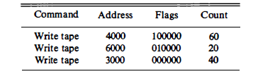
Example of a channel program
Let us take an example of channel program as given below. It consists of three command words.
IBM 370 - Channel program example
The first causes a transfer into a magnetic tape of 60 bytes from memory starting at address 4000.
The next two command words perform a similar function with a different portion of memory and byte count.

Slide 12
Example of a channel program(Cont..)
The six flags in each control word specify certain interrelations between the command words. The first flag is set to 1 in the first command word to specify "data chaining." It results in combining the 60 bytes from the first command word with the 20 bytes of its successor into one record of 80 bytes. The 80 bytes are written on tape without any separation or gaps even though two memory sections were used.
The second flag is set to 1 in the second command word to specify "command chaining." It informs the channel that the next command word will use the same I/O device (tape). The channel informs the tape unit to start inserting a record gap on the tape and proceeds to read the next command word from memory.
The 40 bytes of the third command word are then written on tape as a separate record. When all the flags are equal to zero, it signifies the end of I/0 operations for the particular I/0 device.

Slide 13
IOP Advantages and Disadvantages
Advantages of Input-Output processor
Speeds up the read-write operations as it does not involve a processor.
I/O devices can access the main memory directly.
Reduces the CPU overhead of waiting for I/O to complete.
Increased Scalability - A system can accommodate more input and output devices by adding I/O processors as needed.
Increases the hardware cost.
Cache coherence problem (keeping multiple local caches synchronized) can occur.
Complexity.
Security Risks.
Disadvantages of Input-Output processor

Slide 14
CPU – IOP Communication
The communication channel between the CPU (Central Processing Unit) and the IOP (I/O Processor) depends on the system architecture and design.
In many computer systems, especially in older architectures, the communication between the CPU and IOP was typically facilitated through a combination of buses and interfaces.
This channel explains the commands executed by IOP and CPU while performing some programs.
The CPU do not executes the instructions but it assigns the task of initiating operations, the instructions are executed by IOP.
The data formats of peripheral devices differ from memory and CPU data formats. The lOP must structure data words from many different sources. For example, it may be necessary to take four bytes from an input device and pack them into one 32-bit word before the transfer to memory.

Slide 15
CPU – IOP Communication (Cont..)
Communication channel between CPU and IOP
Whenever CPU gets interrupt from IOP to access memory, this channel starts by CPU, by giving “test IOP path” instruction to IOP and then the communication begins as shown in figure on next slide.
IOP executes the instruction and check for status, if the status given to CPU is OK, then CPU gives start instruction to IOP and gives it some control and get back to some another program. After that IOP is able to access memory for its program.
Now IOP start controlling I/O transfer directly and create another status report as well.
As soon as this I/O transfer completes IOP once again send interrupt to CPU, CPU again request for status of IOP, IOP check status word from memory location and gives it to CPU.
Now CPU check the correctness of status and continues with the same process.

Slide 16
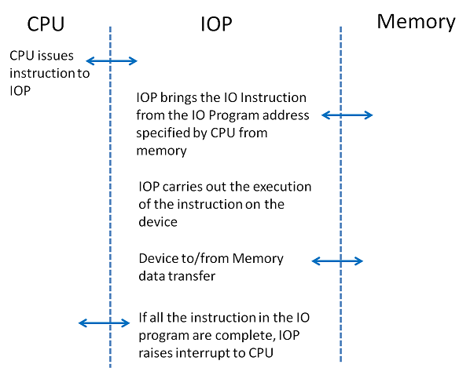
CPU – IOP Communication (Cont..)
The communication steps between CPU, IOP and Memory in completing data transfer is depicted in figure.
Fig: Communication steps in IOP operation

Slide 17
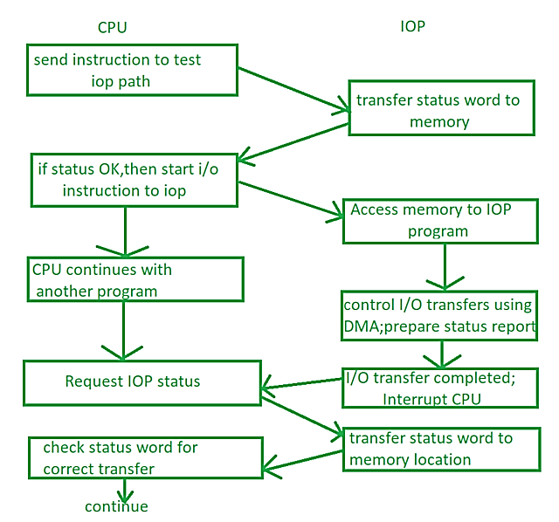
CPU – IOP Communication (Cont..)
Fig: Communication channel between IOP and CPU

